Slide 1

INTRODUCTION TO YOUR PROJECT
The AI agent, known as the "Personal Wellness Mentor," is designed to assist users in achieving their personal well-being goals. This agent uses AI-driven insights and personalized coaching to help users manage their physical and mental health, productivity, and overall well-being. The agent can interact with users to provide tailored guidance and support.
User can choose between agents such as nutritionist, fitness coach and counsellor.
SUMMER HACK

Slide 2
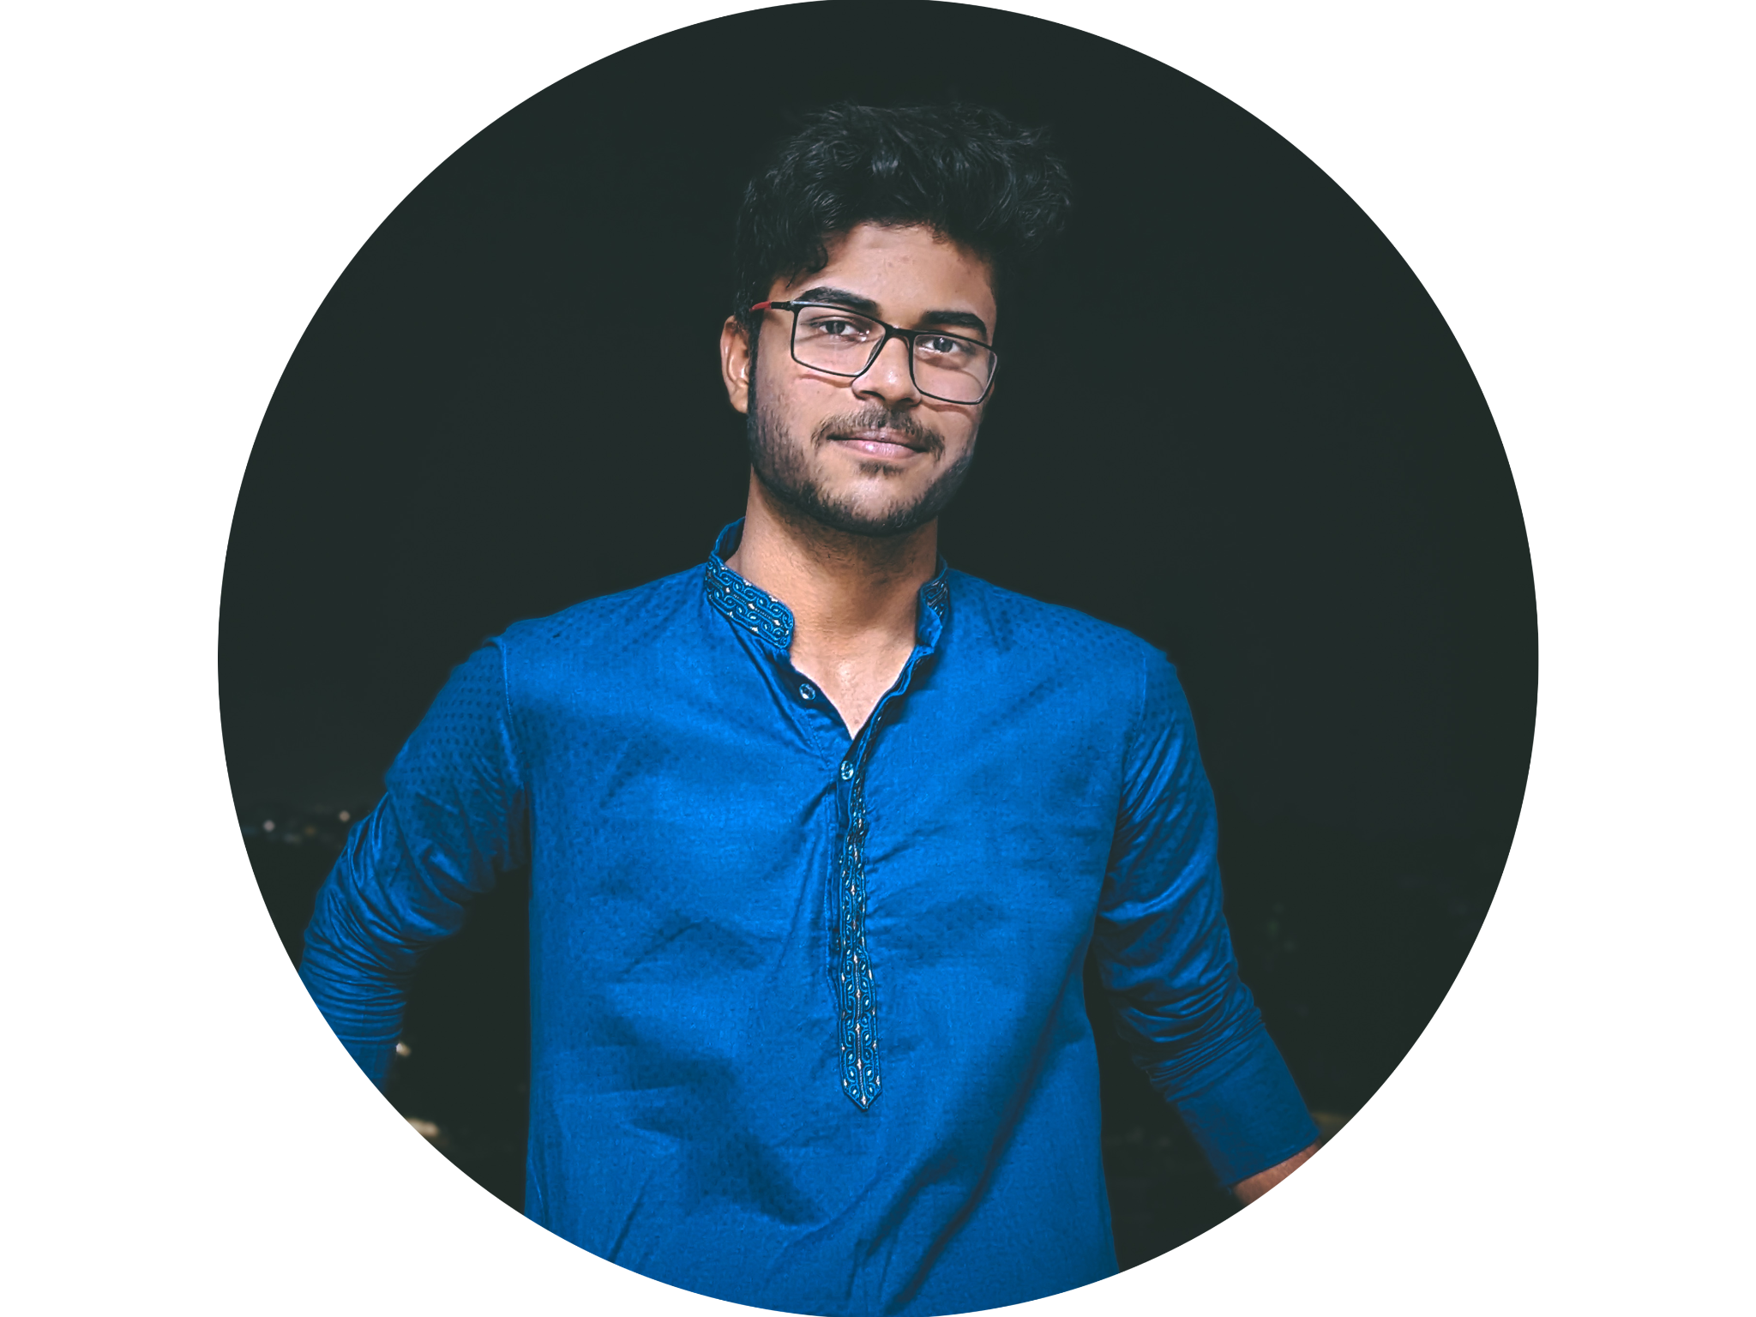


INTRODUCE YOUR TEAM
Frontend & Backend Asutosh Behuria
AI ML & Backend Prerit Agrawal
UI/UX & Frontend
Soham Samantaray
SUMMER HACK

Slide 3
PROBLEM STATEMENT:
AI Agent to improve the physical and psychological health of the user.
User can fine tune the model according to their physical and mental goals. They can set goals for each of their agents (for fitness, nutritionist and counsellor)
SUMMER HACK

Slide 4
STACK YOU ARE PLANNING TO USE:
UI/UX - Figma
Frontend - ReactJS + Typescript
Backend - NodeJS
AI Agent - Python
DB - mongoDB
SUMMER HACK

Slide 5
BLUEPRINT OF THE TOOL:
SUMMER HACK

